Slide 1
Control Subsystem
Fatih ÇALIŞ

Slide 2
Problem Statement and Requirements
Good Control Algorithm
High Maneuver Capability
Easeness of the operation
3 Continuous Variables
2 Digital Variables

Slide 3
Solutions
Differential Drive Method
Rotation around its own axis

Slide 4
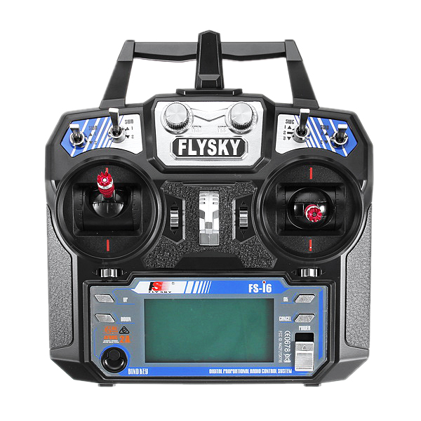
3 Continous Variables:
Movement in Y direction
Movement in X direction
Angle of FPV camera
2 Digital Variables:
Shooting Action
Choosing Mode

Slide 5
Implementation
Sensors
RC Transmitter
Microcontroller
Servo Motor
RC Receiver
FPV Display
FPV Camera
Motor Driver
Motor Driver
DC Motors
Step Motor
Remote Control
On-Board Control

Slide 6
Test Results
RC Transmitter Tests:
Range:
Line of Sight : Around 250m
With Obstacles: Around 100m
Sensor Tests:
Distance Sensor (HCSR-04):
Measurement Range: 1cm – 400cm
Without Delay : 1cm – 50cm
Color Sensor (TCS3200)
Requires good threshold adjusting

